Slide 1
Reshaping Body Image
How are overweight and obese people treated in our society?
Mr. Davis Mr. Cian Miss Berger

Slide 2
What are your first impressions?

Slide 8
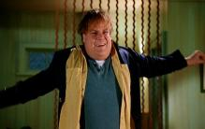

Slide 9
Discussion
•
What were some of the first words that came to mind about these people?

Slide 10
Discussion
•
What were some of the first words that came to mind about these people?
•
Did you have any impressions about the health and happiness of each person? What were they?

Slide 11
Discussion
•
What were some of the first words that came to mind about these people?
•
Did you have any impressions about the health and happiness of each person? What were they?
•
Did you have any impressions about the level of intelligence or success of each person? What were they?

Slide 12
Discussion
•
What were some of the first words that came to mind about these people?
•
Did you have any impressions about the health and happiness of each person? What were they?
•
Did you have any impressions about the level of intelligence or success of each person? What were they?
•
Did you write down any words about how attractive or unattractive each person is? What words did you use?

Slide 13
Discussion
•
What were some of the first words that came to mind about these people?
•
Did you have any impressions about the health and happiness of each person? What were they?
•
Did you have any impressions about the level of intelligence or success of each person? What were they?
•
Did you write down any words about how attractive or unattractive each person is? What words did you use?
•
Did you write down any words about the body size or shape of each person? Which ones? What words did you use to describe their bodies?

Slide 14
Discussion
•
What were some of the first words that came to mind about these people?
•
Did you have any impressions about the health and happiness of each person? What were they?
•
Did you have any impressions about the level of intelligence or success of each person? What were they?
•
Did you write down any words about how attractive or unattractive each person is? What words did you use?
•
Did you write down any words about the body size or shape of each person? Which ones? What words did you use to describe their bodies?
•
Were your “first impressions” of the women different from your feelings about the men?

Slide 15
Body Image Web
Where are some places people in today’s society get their ideas and perceptions about body image?

Slide 16
Body Image Web Directions
Now each group should discuss the ways in which that category has shaped our ideas about body image and our perceptions about people who fall outside what is considered “normal” or attractive.
Everyone in the group should be ready to present information when called upon.

Slide 17
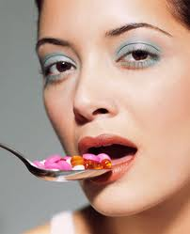
Perceptions of How to Improve Body Image
These are seen as the “Easy Way” to all your body needs:
Plastic Surgery
Anabolic Steroids
Fad Diets
Diet Pills
Anorexia
Bulimia

Slide 18
Complications
abnormal heart rhythm
blood clots
brain damage
Tooth decay
heart attack
nerve damage
stroke
temporary paralysis
Liver Damage
Kidney problems
High Blood Pressure
High cholesterol
Stunted growth
Personality Disorders
WEIGHT PROBLEMS
DEATH

Slide 19
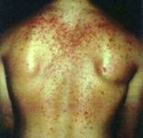
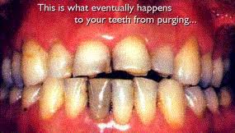
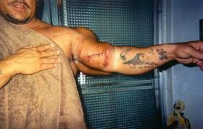
Is it worth it?

Slide 20
Myth or Fact
DIRECTIONS: Please take your colored cards to respond to the following questions.
Red = Myth
Green = Fact

Slide 21
Myth or Fact
Barbie and Ken are made to scale of real people.

Slide 22
Myth or Fact
Myth:
If Barbie were a real woman-She would have to grow to be seven feet tall. Barbie's weight would be 110 pounds. If she were a real woman-Barbie would have to walk on all fours due to her proportions. If Ken were a real man-he would be seven-feet, eight-inches tall. An average man would have to add seven inches to his chest and about eight inches to his neck to equal Ken's measurements.

Slide 23
Myth or Fact
Overweight people are all at a health risk.

Slide 24
Myth or Fact
Myth:
There are both health risks and benefits associated with being overweight. Research seems to indicate that the healthiest weight is a stable weight, even if a person weighs more than average. The best way to maximize your health is to adopt a healthy lifestyle, which includes regular physical activity.

Slide 25
Myth or Fact
There is no such thing as too much exercise.

Slide 26
Myth or Fact
MYTH:
Compulsive exercising is a disorder and exercising too much can have serious physical and emotional effects. Exercise becomes a problem, or an addiction, when you prioritize it over most other parts of your life. You may feel anxious, guilty, unattractive or out of control when you are unable to exercise. You may continue to exercise even when it poses a risk to your health.

Slide 27
Myth or Fact
You have to exercise a lot to get any benefits.

Slide 28
Myth or Fact
MYTH:
There are big health benefits in accumulating 30 minutes of moderate activity on most days. But any movement is better than no movement. You could start with a five-minute walk today and build up from there!

Slide 29
Myth or Fact
Obese or overweight people are bigger because they are lazy.

Slide 30
Myth or Fact
MYTH:
All of our bodies have a different natural baseline size and while food intake and exercise may contribute to changing this some, there are also many other factors involved that can't be controlled, such as metabolism, bone structure and genetics. Just because someone is overweight does not mean they are anymore lazy than someone who is thinner.

Slide 31
Myth or Fact
I will be able to tell if someone has an eating disorder.

Slide 32
Myth or Fact
MYTH:
Many people with eating disorders are very good at hiding their eating and exercising habits. Even if they do not meet the medical criteria for size, weight or behavior of an eating disorder, it does not mean that they do not need help. Eating disorders get worse as they go on and it's even possible for the person with the eating disorder to not know that there is a problem.

Slide 33
Myth or Fact
Eating disorders are only a woman’s problem.

Slide 34
Myth or Fact
MYTH:
Eating disorders affect many people regardless of sex, gender identity, race, ethnicity, age, class or sexual orientation. All types of eating disorders affect men as well as women, including anorexia, bulimia, compulsive overeating, and over-exercise. Due to the myth that eating disorders don't affect men, fewer men who have eating disorders have actually been labeled as such.

Slide 35
Myth or Fact
All obese people are compulsive overeaters.

Slide 36
Myth or Fact
MYTH:
The compulsive eater, whether overweight or thin, is a person with an eating disorder. Simply being overweight does not indicate the presence of an eating disorder. Studies which set out to prove that overweight people eat more than thin people concluded that there is no measurable difference in the food consumption of overweight and thin people

Slide 37
Myth or Fact
If I hate my body, there is nothing I can do about it.

Slide 38
Myth or Fact
MYTH:
There may be little you can do to change the body you have, but there are many things you can do to change your way of thinking about your body. To build your body-confidence, try new activities and find things that your body is good at doing. For every negative thought you have about your body come up with a positive one to counter it. Try not to break your body down into parts, but rather think of it as a whole, functional unit.

Slide 39
Advocacy Cues
Takes a clear, health-enhancing stand/position
Supports the position with relevant information
Shows awareness of audience
Encourages others to make healthful choices
Demonstrates passion/conviction

Slide 40
Self Reflection
Silently reflect on how many times a day you JUDGE (or hear others judge) your own or someone else’s size or appearance.
What effects do these judgments have on us at the moment and over time?

Slide 41
Self Reflection
DIRECTIONS: Turn over your index card from the opening activity and write your responses to the following:
List at least TWO physical features that you like about yourself. How can you learn to accept and like your body?
How can we avoid judging others based on physical size or appearance, and place emphasis on the internal qualities over the external qualities in others?

Slide 42
Body Positive World
DIRECTIONS: Pick two of the 15 ways to create a body positive world and write a narrative as to how you would apply it to your everyday life.
**See Rubric for Criteria.

Slide 43
Body Positive World
Example: (1) Encourage Positive Comments
While I am looking in the mirror at myself, instead of stating all the negatives (like bad hair day, weird outfit) I will say all the positives out loud. For every negative I think or say about myself, I will then say a positive out loud.
I will also do the same within my classes. Anytime I hear anyone saying anything bad about themselves or others, I will immediately compliment them with a positive comment so that they see the positives rather than the negatives of themselves, or others.

Slide 44
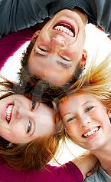
The best and most beautiful thing in life cannot be seen, not touched, but are felt in the heart.
- Hellen Keller

