Slide 1
Physical Education Expectations
Safety and Sportsmanship
to make P.E. the best it can be!!!

Slide 2
Why Have Rules?
Keep things FAIR
Keep things SAFE
Keep things FUN

Slide 3
Safety First
How can we be safe in P.E. Class?

Slide 4
Safety Do’s and Don'ts
DO
Don’t
Stay in your own bubble!
Tag Nicely below the head
Stay on your feet!
Get up when you fall
Tell the teacher when someone gets hurt
Run into other students
Tag in the face
Slide on the floor
Lay down during the game
Take yourself out of the game

Slide 5
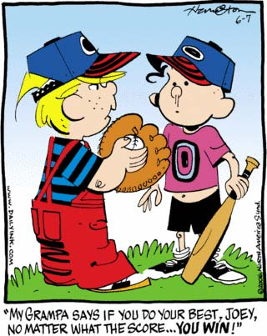
Be A Good Sport!
What does it mean to be a Good Sport?
Play Fair, Show Respect
Good “Winner” and Good “Loser”
How can show
Sportsmanship
during P.E.?

Slide 6
Sportsmanship
Read the following situations and say how we could show good sportsmanship:
While playing a tagging game, the person you tag does not leave the game.
When playing soccer, your team loses by a point.
When running through the gym, you accidently collide with another student and knock them down.

Slide 7
Sportsmanship
When playing a collection game, one of your team mates cheats and takes more than one puff ball at a time.
As you enter class, someone takes the spot on the floor that you wanted.
During class, you hear your friends picking on another student who they think is not good at the game.

Slide 8
Show off YOU!!!
Show RESPECT!
Be a good sport!
Follow the Rules!
Play Safe!
Have fun and help
others have fun!
Show how you can be the best YOU Possible!

